Slide 1
Wednesday

Slide 2
Course Logistics
Weekly Activity – Piazza Introduction
Due Wednesday, January 25 @ 11:15 AM (i.e. before class)
Weekly Activity – Syllabus Quiz
Due Monday, January 30 @ 11:15 AM
Problem Set 1 – releases today
Due Wednesday, February 8 @ 11:59 PM (i.e. as late as possible)
This will move if it is not released today.
Orienting yourself to the syllabus, calendar, weekly modules, etc.
It is add / drop day!

Slide 3
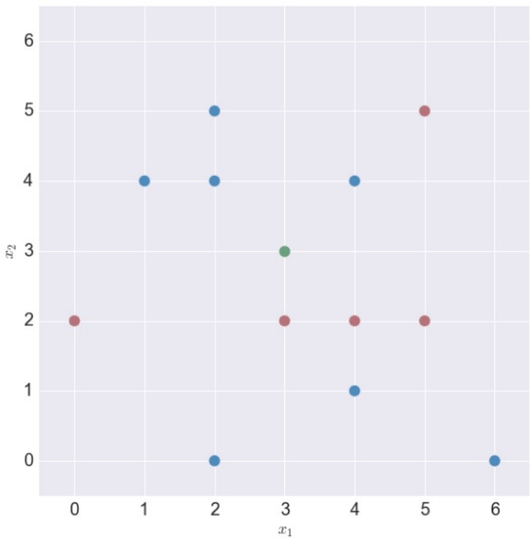
KNN
0.8
1.7
0.4
0.6
1.2
-2.1
-0.1
0.2
0.6
-0.5
-1.5
-0.6

Slide 4
Start-To-Finish ML

Slide 5
Data Analytics Cycle
Adapted from Clow 2012: https://dl.acm.org/doi/pdf/10.1145/2330601.2330636
& Labrinidis & Jagadish, 2012 (as interpreted by Gandomi & Haider, 2015): https://www.sciencedirect.com/science/article/pii/S0268401214001066
Collecting
Presenting
Cleaning
Interpreting
Analyzing

Slide 6
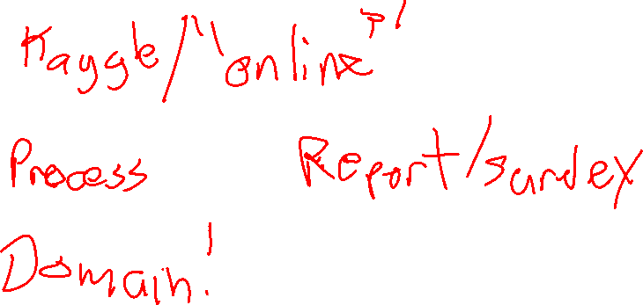
Collecting Data
Where do “Data” come from?

Slide 7
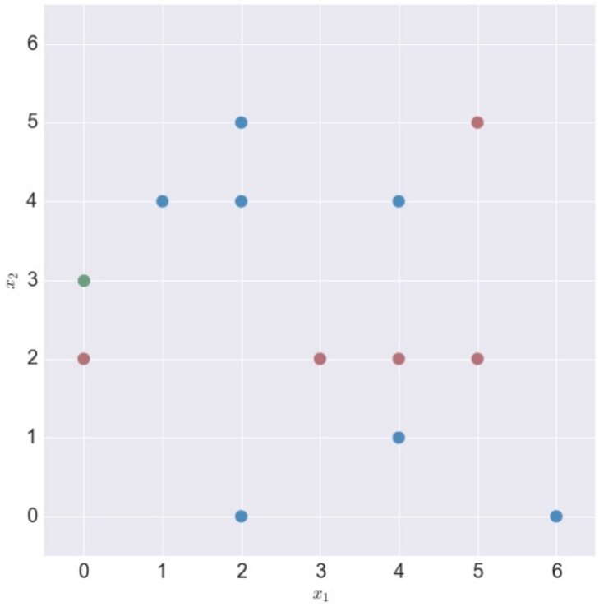
Our Toy Dataset
X₁ and X₂ are our features X
The Shape (Star or Heart) is our outcome Y

Slide 8
Prediction – College Admission
Student | X₁ | X₂ | Y
A | 1200 | 26 | 1
B | 1450 | 28 | 1
C | 1000 | 20 | 1
D | 730 | 15 | -1

Slide 9
Data Analytics Cycle
Adapted from Clow 2012: https://dl.acm.org/doi/pdf/10.1145/2330601.2330636
& Labrinidis & Jagadish, 2012 (as interpreted by Gandomi & Haider, 2015): https://www.sciencedirect.com/science/article/pii/S0268401214001066
Collecting
Presenting
Cleaning
Interpreting
Analyzing

Slide 10
Our Toy Dataset
X₁ and X₂ are our features X
The Shape (Star or Heart) is our outcome Y
Is this going to be easy to feed into Python?

Slide 11
Our Toy Dataset
Represent your data in a Table (/ Data Frame / etc.)

Slide 12
Our Toy Dataset
features = [
[0,2],
[0,3],
[1,4],
[2,0],
…
[6,0]
]
labels = [
star,
star,
heart,
heart,
…
heart
]

Slide 13
Prediction – College Admission
What are you going to predict for this case with K = 1, using Manhattan distance?
Student | X₁ | X₂ | Y
A | 1200 | 26 | 1
B | 1450 | 28 | 1
C | 1000 | 20 | 1
D | 730 | 15 | -1
NEW | 720 | 16 | ???

Slide 14

Prediction – College Admission
What are you going to predict for this NEW case with K = 1, using Manhattan distance?
Student | X₁ | X₂ | Y
A | 1200 | 26 | 1
B | 1450 | 28 | 1
C | 1180 | 20 | 1
D | 730 | 15 | -1
NEW | 950 | 30 | ???

Slide 15
Prediction – College Admission
The X₁ feature is overpowering the X₂ feature!
Student | X₁ | X₂ | Y
A | 1200 | 26 | 1
B | 1450 | 28 | 1
C | 1180 | 20 | 1
D | 730 | 15 | -1
NEW | 950 | 30 | ???

Slide 16
Euclidian Distance – N-Dimensional Vector
Euclidian Distance: ||x_{i} – x||²
X₁ | X₂ | X₃ | X₄ | Y | Distance
2 | 5 | 9832 | .005 | Positive
4 | 82 | 9421 | .008 | Positive
3 | 17 | 9321 | .04 | Negative
4 | 90 | 9128 | .001 | Negative

Slide 17
Euclidian Distance – N-Dimensional Vector
Euclidian Distance: ||x_{i} – x||²
X₁ | X₂ | X₃ | X₄ | Y | Distance
2 | 5 | 9832 | .005 | Positive
4 | 82 | 9421 | .008 | Positive
3 | 17 | 9321 | .04 | Negative
4 | 90 | 9128 | .001 | Negative
3 | 16 | 9830 | .04 | ???

Slide 18
Euclidian Distance – N-Dimensional Vector
Euclidian Distance: ||x_{i} – x||²
X₁ | X₂ | X₃ | X₄ | Y | Distance
2 | 5 | 9832 | .005 | Positive | 126.001
4 | 82 | 9421 | .008 | Positive | 171638.001
3 | 17 | 9321 | .04 | Negative | 259082
4 | 90 | 9128 | .001 | Negative | 498281.0015
3 | 16 | 9830 | .04 | ???

Slide 19
Euclidian Distance – N-Dimensional Vector
Euclidian Distance: ||x_{i} – x||²
X₁ | X₂ | X₃ | X₄ | Y | Distance
2 | 5 | 9832 | .005 | Positive | 126.001
4 | 82 | 9421 | .008 | Positive | 171638.001
3 | 17 | 9321 | .04 | Negative | 259082
4 | 90 | 9128 | .001 | Negative | 498281.0015
3 | 16 | 9830 | .04 | Positive?

Slide 20
Min-Max Scaling
Transform X (Data) to X’ (Scaled Data)
For (x_{i}) in X
scale = max(x_{i}) – min(x_{i})
low = min(x_{i})
For (x_{i,j}) in (x_{i})
x’_{i,j} = (x_{i,j} – low)/ scale
https://en.wikipedia.org/wiki/Feature_scaling

Slide 21
Scaling – N-Dimensional Vector
Euclidian Distance: ||x_{i} – x||²
X₁ | X₂ | X₃ | X₄ | Y | Distance
0 | 0 | 1 | 0.103 | Positive | 1.07
1 | 0.906 | 0.416 | 0.179 | Positive | 1.87
.5 | 0.141 | 0.274 | 1 | Negative | 0.52
1 | 1 | 0 | 0 | Negative | 3.00
.5 | 0.129 | 0.997 | 1 | Negative

Slide 22
Scaling – Housing Market?
Euclidian Distance: ||x_{i} – x||²
# Bedrms | Acres | Sq. Ft. | Radon | New Build? | Distance
2 | 5 | 9832 | .005 | Positive
4 | 82 | 9421 | .008 | Positive
3 | 17 | 9321 | .04 | Negative
4 | 90 | 9128 | .001 | Negative

Slide 23
Scaling – College Prediction
Student | SAT | ACT | GPA | Graduated?
A | 1200 / 1600 | 26 / 36 | 3.2 / 4.0 | Yes
B | 1450 / 1600 | 28 / 36 | 3.5 / 4.0 | Yes
C | 1000 / 1600 | 20 / 36 | 3.0 / 4.0 | Yes
D | 730 / 1600 | 15 / 36 | 2.0 / 4.0 | No
NEW | 720 / 1600 | 16 / 36 | 2.2 / 4.0 | ???

Slide 24
Normalization
Transform X (Data) to X’ (Scaled Data)
For (x_{i}) in X
mean = avg (x_{i})
dev = stdev (x_{i})
For (x_{i,j}) in (x_{i})
x’_{i,j} = (x_{i,j} – mean) / dev
https://en.wikipedia.org/wiki/Feature_scaling
https://en.wikipedia.org/wiki/Feature_scaling

Slide 25
Euclidian Distance – N-Dimensional Vector
Euclidian Distance: ||x_{i} – x||²
X₁ | X₂ | X₃ | X₄ | Y | Distance
-1.30558 | -0.9954294 | 1.368526 | -0.4749171 | Positive
0.7833494 | 0.7665950 | -0.0151497 | -0.3072993 | Positive
-0.261116 | -0.7208282 | -0.351810 | 1.480624 | Negative
0.7833494 | 0.9496625 | -1.001566 | -0.6984075 | Negative
-0.2611164 | -0.7437116 | 1.3617933 | 1.480624 | ???

Slide 26
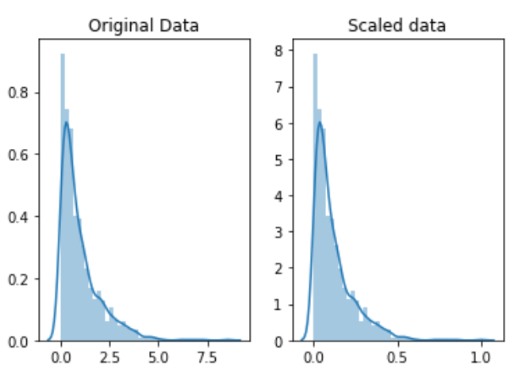
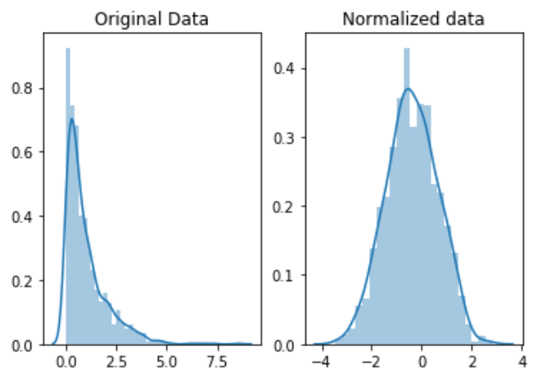
Side Note: Feature Scaling vs. Normalizing

Slide 27
Data Analytics Cycle
Adapted from Clow 2012: https://dl.acm.org/doi/pdf/10.1145/2330601.2330636
& Labrinidis & Jagadish, 2012 (as interpreted by Gandomi & Haider, 2015): https://www.sciencedirect.com/science/article/pii/S0268401214001066
Collecting
Presenting
Cleaning
Interpreting
Analyzing

Slide 28
Find the Nearest Neighbors
Classification
Our objective – Predicting a class
Did we get it right?
How do we know we got it right?

Slide 29
How do we know if it works?
Classify ones we already know the answer to!

Slide 30
Accuracy

Slide 31
Homework 1 – Training & Test Sets
Train a KNN on everything
K = 1
What does my nearest neighbor to X look like?
My Data

Slide 32
Homework 1 – Training & Test Sets
Test Data
Divide it into training and testing sets!
Train Data

Slide 33
Types of Errors
Classified As Ground Truth | C | ~C
C
~C

Slide 34
Types of Errors
Classified As Ground Truth | C | ~C
C | True Positive (Hit) | False Negative (Miss)
~C | False Positive (False Alarm) | True Negative (Correct Rejection)

Slide 35
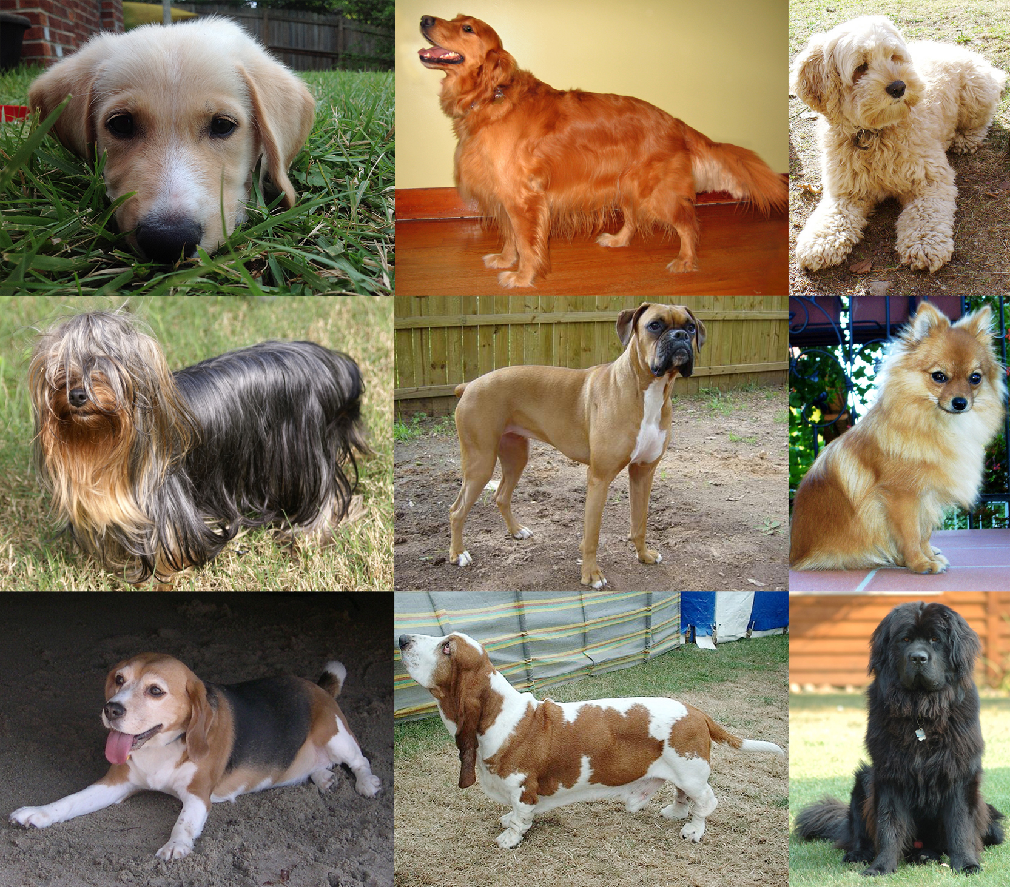
Types of Errors

Slide 36
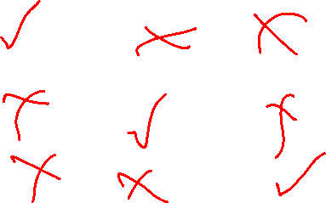
Types of Errors
Classified As Ground Truth | A | B | C
A
B
C

Slide 37
Types of Errors
Classified As Ground Truth | A | B | C
A | hit | miss | miss
B | miss | hit | miss
C | miss | miss | hit

Slide 38
Types of Errors
Classified As Ground Truth | C | ~C
C | True Positive (Hit) | False Negative (Miss)
~C | False Positive (False Alarm) | True Negative (Correct Rejection)

Slide 39
How do we know if it works?

Slide 40
How do we know if it works?
Uh oh…

Slide 41
Homework 1 – Training & Test Sets
Test Data
I pull out the last 20% of samples
But what if they were put in order?
Train Data

Slide 42
How do we know if it works?

Slide 43
Homework 1 – Training & Test Sets
Train Data
I pull out a random 20% of my data
Now I have something (probably) representative, AND
I’m not just testing inherent bias of my model or data
Test Data

Slide 44
Euclidian Distance – N-Dimensional Vector
Euclidian Distance: ||x_{i} – x||²
Where do we get our Mean and St. Dev.?
X₁ | X₂ | X₃ | X₄ | Y | Distance
-1.30558 | -0.9954294 | 1.368526 | -0.4749171 | Positive
0.7833494 | 0.7665950 | -0.0151497 | -0.3072993 | Positive
-0.261116 | -0.7208282 | -0.351810 | 1.480624 | Negative
0.7833494 | 0.9496625 | -1.001566 | -0.6984075 | Negative
-0.2611164 | -0.7437116 | 1.3617933 | 1.480624 | ???

Slide 45
Euclidian Distance – N-Dimensional Vector
Euclidian Distance: ||x_{i} – x||²
X₁ | X₂ | X₃ | X₄ | Y | Distance
2 | 5 | 9832 | .005 | Positive
4 | 82 | 9421 | .008 | Positive
3 | 17 | 9321 | .04 | Negative
4 | 90 | 9128 | .001 | Negative
3 | 16 | 9830 | .04 | ???
Train
Test

Slide 46
Training & Test Sets
Train Data
I pull out a random 20% of my data
Now I have something (probably) representative, AND
I’m not just testing inherent bias of my model or data
Test Data

Slide 47
Training & Test Sets
Train Data
I have sold a variety of houses (train data)
I develop data transformations based on these data
I apply the same transformations to future samples (test data)
Test Data

Slide 48
Min-Max Scaling
Transform X_train (Train Data) to X_train’ (Scaled Train Data)
For x_{i} (each column) in X_train
scale = max(x_{i}) – min(x_{i})
low = min(x_{i})
For x_{i,j} (sample) in x_{i}
x’_{i,j} = (x_{i,j} – low)/ scale
Transform X_test (Test Data) to X_test’ (Scaled Test Data)
For (x_{i}) in X_test
For (x_{i,j}) in (x_{i})
x’_{i,j} = (x_{i,j} – low)/ scale
https://en.wikipedia.org/wiki/Feature_scaling

Slide 49
Normalization
Transform X_train (Data) to X_train’ (Scaled Data)
For (x_{i}) in X
mean = avg (x_{i})
dev = stdev (x_{i})
For (x_{i,j}) in (x_{i})
x’_{i,j} = (x_{i,j} – mean) / dev
Transform X_test (Test Data) to X_test’ (Scaled Test Data)
For (x_{i}) in X_test
For (x_{i,j}) in (x_{i})
x’_{i,j} = (x_{i,j} – mean)/ dev
https://en.wikipedia.org/wiki/Feature_scaling
https://en.wikipedia.org/wiki/Feature_scaling

Slide 50
Normalization / Scaling
Normalization and Scaling are important for us to consider
- It will allow us to consider variables on equal footing
Normalization and Scaling are important for us to consider on a case by case basis
- Sometimes a “default” transformation won’t make sense

Slide 51
Data Analytics Cycle
Adapted from Clow 2012: https://dl.acm.org/doi/pdf/10.1145/2330601.2330636
& Labrinidis & Jagadish, 2012 (as interpreted by Gandomi & Haider, 2015): https://www.sciencedirect.com/science/article/pii/S0268401214001066
Collecting
Presenting
Cleaning
Interpreting
Analyzing

Slide 52
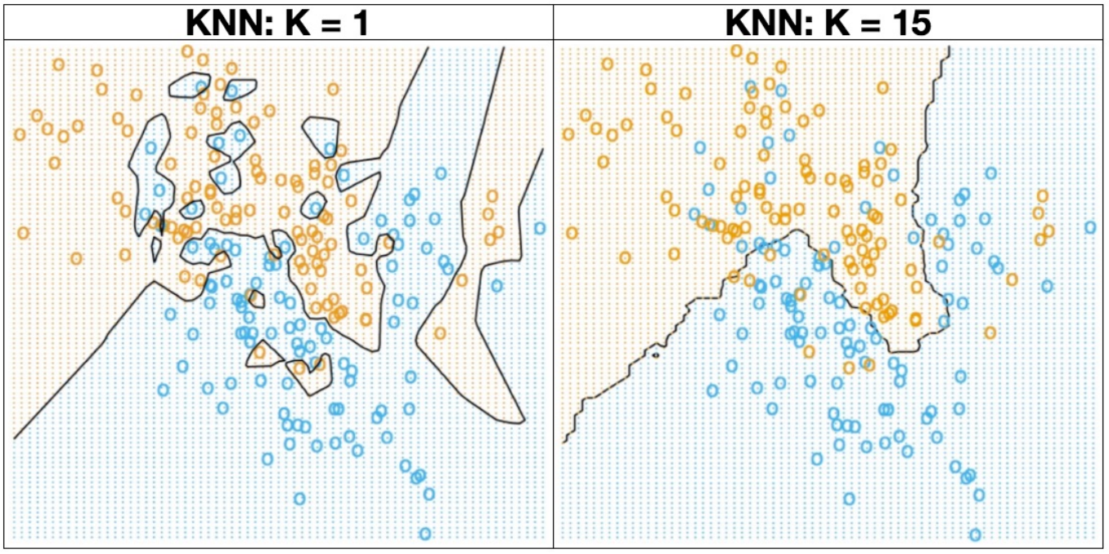
KNN – Small K
What do you notice about this space?
Any odd cases (outliers) still have a significant impact on the prediction

Slide 53
KNN – Large K
What do you notice about this space?
We are very imprecise with our border, we lose a lot of nuance in edge cases.

Slide 54
KNN – Small K
Overfitting – allowing individual samples to have too much power in determining our outcome.

Slide 55
KNN – Large K
Underfitting – giving individual samples too little power in determining our outcome.

Slide 56
KNN – “Correct” # for K?
It depends
(You’re going to get really tired of this answer…)
Probably more than 1
We worry about outliers
Probably less than 15
but it depends on the number of samples in your dataset and the distribution of your data
3, 5, 7, etc. are (relatively) common.

Slide 57
Optimizing K using a Validation Set
Build a model using a first K (K=1)…
Train Data

Slide 58
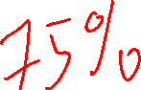
Optimizing K using a Validation Set
Build a model using a first K (K=1)…
Check how good your K=1 Model does…
Train Data
Validation Data

Slide 59
Optimizing K using a Validation Set
Build a model using a first K (K=1)…
Check how good your K=1 Model does…
Hang on to that information (accuracy, etc.)
Train Data
Validation Data

Slide 60
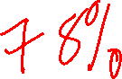
Optimizing K using a Validation Set
Build a model using a second K (K=2)…
Check how good your K=2 Model does…
Compare your K=2 model to your K=1 model. Which one is better?
Hang on to that information (accuracy, etc.)
Train Data
Validation Data

Slide 61

Optimizing K using a Validation Set
For K=k from m to n (usually 1 to n):
Build a model using k…
Check how good your K=2 Model does…
Compare your m – n models. Which one is best?
Train Data
Valid-ation Data

Slide 62
Optimizing K using a Validation Set
Valid-ation Data
You’ve used the Train and Validation data a lot…
It’s not very clean to report your “validation” accuracy, because you worked hard finding the K (hyperparameter) that was the very best. That’s “cheating” (from a success perspective, not from a class perspective).
Train Data

Slide 63
Optimizing K using a Validation Set
Valid-ation Data
You’ve used the Train and Validation data a lot…
It’s not very clean to report your “validation” accuracy, because you worked hard finding the K (hyperparameter) that was the very best. That’s “cheating” (from a success perspective, not from a class perspective).
You need a Test dataset that is untouched to see how good your model really does.
Train Data
Test Data

Slide 64
Sidebar – Training, Validation, Testing sets
1) Training Set – used in the (usually iterative) training process
2) Validation Set – kept out of the training process, used to meter your training process
3) Testing Set – Used to evaluate the accuracy, etc. of your learning

Slide 65
Optimizing K using a Validation Set
Valid-ation Data
You’ve used the Train and Validation data a lot…
It’s not very clean to report your “validation” accuracy, because you worked hard finding the K (hyperparameter) that was the very best. That’s “cheating” (from a success perspective, not from a class perspective).
You need a Test dataset that is untouched to see how good your final model really does.
This is what you would report to others as the expected goodness of your model.
Train Data
Test Data

Slide 66
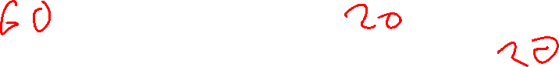
Training & Hold-Out & Test Sets
Train Data
Validation Data
I pull out another random 20% of my data
If my dataset is smaller, I’m starting to run out of data… To Be Continued!
Test Data

Slide 67
K-Nearest Neighbors Algorithmic Complexity
One Query, m training examples, each with D features
O(m*D)
For the Naïve Case
Scikit-learn has additional details in their implementation: https://scikit-learn.org/stable/modules/neighbors.html

Slide 68
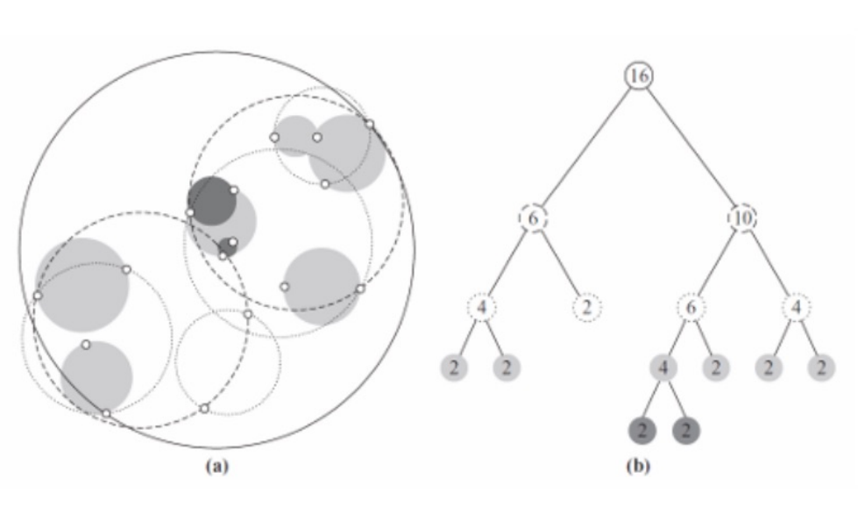
K-Nearest Neighbors – Tree Structure

Slide 69
Errors (Continued)

Slide 70
Ready for Problem Set 1!

Slide 71

Problem Space – College Admissions (Week 1)
The following scenario isn’t fully true, but it’s close to what we do in college admissions…
I am trying to decide if a student should be admitted to my university. I have their SAT and ACT scores and their HS GPA. I also have the history of students who have attended in the past, their SAT / ACT / HS GPA as well as whether or not they graduated. I only want to admit new students if they will graduate.

Slide 72
What is an Error?
We’ve looked at trying it out on a test set and getting an “accuracy”
Accuracy = # correct / # total
What is our “test set”?
Are all mistakes created equal?

Slide 73
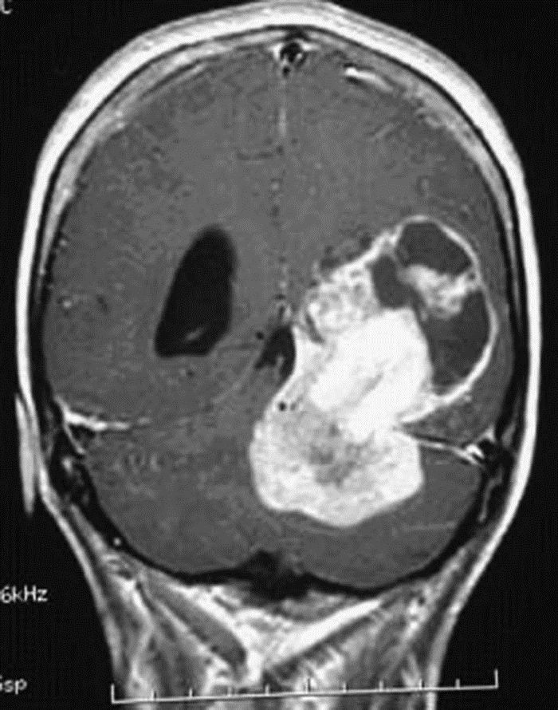
What makes an error?

Slide 74
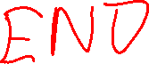
Types of Errors
Classified As Ground Truth | Cancer | Not Cancer
Cancer | True Positive (Hit) | False Negative (Miss)
Not Cancer | False Positive (False Alarm) | True Negative (Correct Rejection)

